Slide 1
Midterm Exam 1 is next Tuesday in class
Topics covered: Python Knowledge, Uninformed Search, Informed Search, Constraint Satisfaction Problems, Adversarial Search.
You should read AIMA Chapters 2.1 and 2.2, 3.1-3.6, 5.2-5.5, 6.1-6.5, and 16.1-16.3.
The midterm is a closed book exam. No notes. No devices.
I will release a practice exam tonight on Piazza.

Slide 2
HW4 has been released
This HW is all about games: Sudoku solver! Dominoes! It’s fun but will take more time than past HWs. We’re giving you 3 weeks to turn it in.
(Don’t thank us – you’ll be studying for the midterm this week, on Winger break next week, and finally doing your HW the following week).
The assignment is due on Tuesday, October 16, 2018 before 11:59PM.

Slide 3

Adversarial Search
Read AIMA Chapter 5.2-5.5,
And Chapter 16.1-16.3

Slide 4
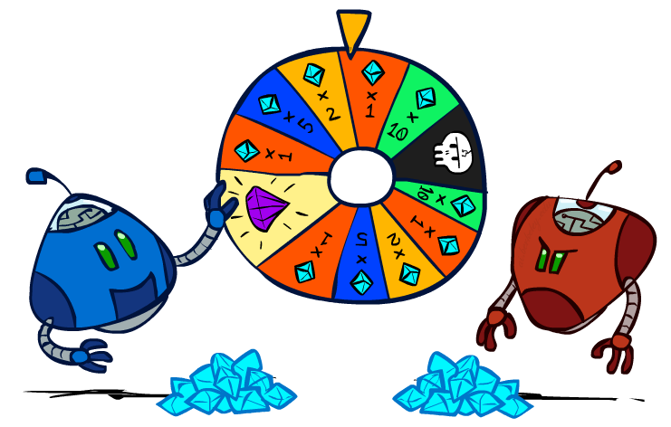
Adversarial Search 2: Uncertainty and Utilities
Slides courtesy of Dan Klein and Pieter Abbeel
University of California, Berkeley
[These slides were created by Dan Klein and Pieter Abbeel for CS188 Intro to AI at UC Berkeley. All CS188 materials are available at http://ai.berkeley.edu.]
Notes:
Please retain proper attribution, including the reference to ai.berkeley.edu. Thanks!

Slide 5
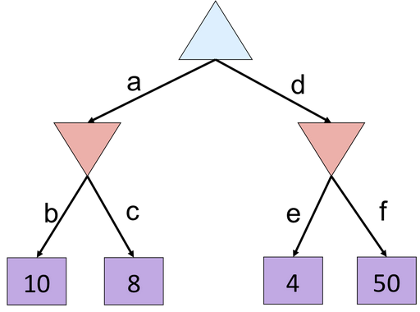
Review: Minimax and Alpha-Beta 1

Slide 6
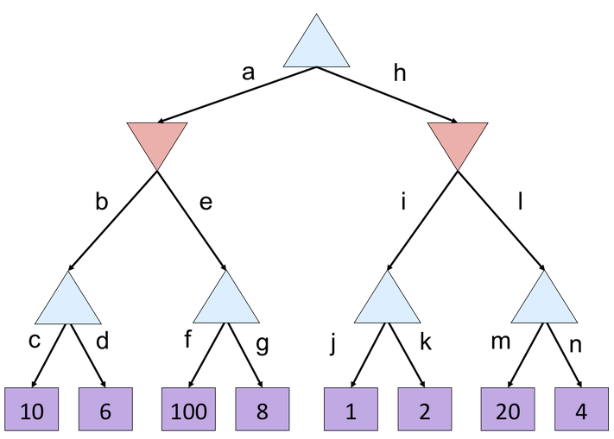
Review: Minimax and Alpha-Beta 2

Slide 7
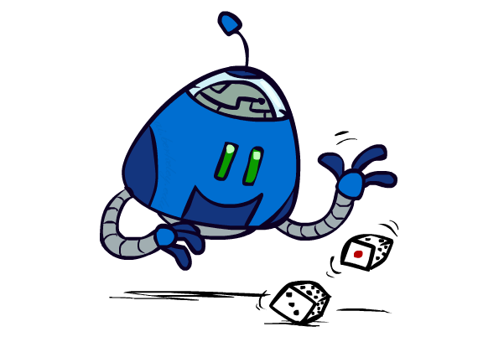
Uncertain Outcomes

Slide 8
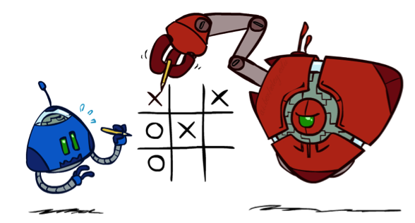

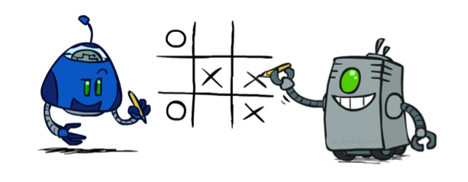
Worst-Case vs. Average Case
max
min
10
10
9
100
Idea: Uncertain outcomes controlled by chance, not an adversary!
Notes:
At least 10, or otherwise just rather dead; or just 100, or otherwise rather dead; that’s yet something different than minimax or expectimax
Down arrows = min nodes
Circles = chance nodes.

Slide 9
Expectimax Search
Why wouldn’t we know what the result of an action will be?
Explicit randomness: rolling dice
Unpredictable opponents: the ghosts respond randomly
Actions can fail: when moving a robot, wheels might slip
Values should now reflect average-case (expectimax) outcomes, not worst-case (minimax) outcomes
Expectimax search: compute the average score under optimal play
Max nodes as in minimax search
Chance nodes are like min nodes but the outcome is uncertain
Calculate their expected utilities
I.e. take weighted average (expectation) of children
Later, we’ll learn how to formalize the underlying uncertain-result problems as Markov Decision Processes
max
chance
10
10
4
10
5
9
7
100
[Demo: min vs exp (L7D1,2)]

Slide 10
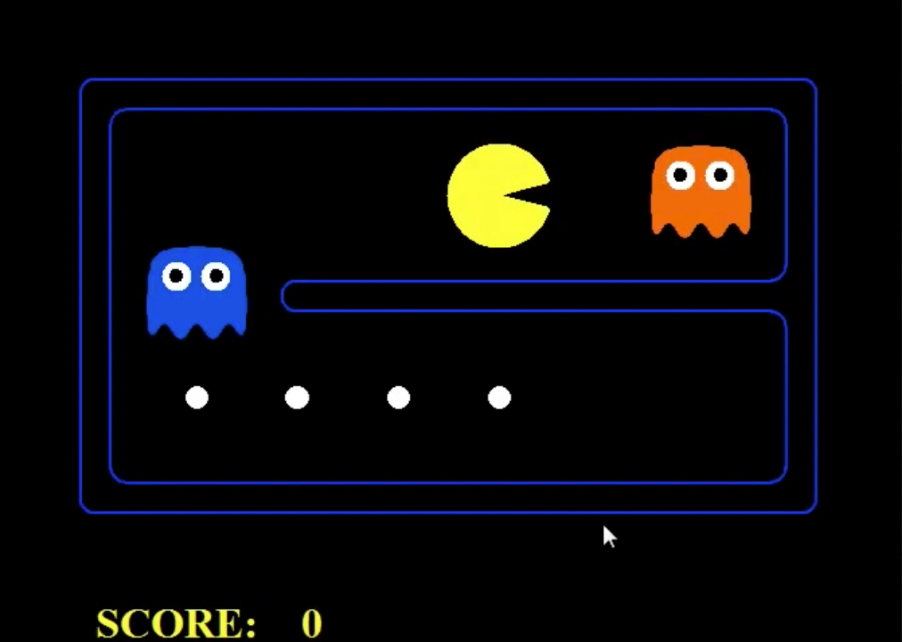
Video of Minimax Pacman

Slide 11
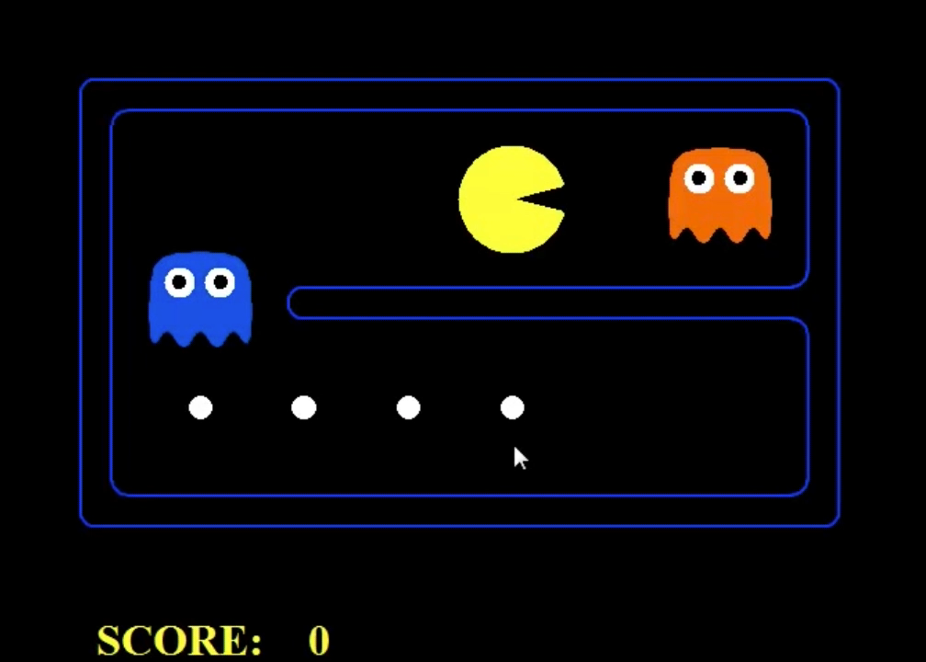
Video of Expectimax Pacman

Slide 12
Expectimax Pseudocode
def value(state):
if the state is a terminal state: return the state’s utility
if the next agent is MAX: return max-value(state)
if the next agent is EXP: return exp-value(state)
def max-value(state):
initialize v = -∞
for each successor of state:
v = max(v, value(successor))
return v
def exp-value(state):
initialize v = 0
for each successor of state:
p = probability(successor)
v += p * value(successor)
return v
Notes:
Max is just like before. Exp is the expectation of what will happen next.

Slide 13
Expectimax Pseudocode
def exp-value(state):
initialize v = 0
for each successor of state:
p = probability(successor)
v += p * value(successor)
return v
1/2
1/6
1/3
5
8
7
24
-12
v = (1/2) (8) + (1/3) (24) + (1/6) (-12) = 10

Slide 14
Expectimax Example
3
12
9
2
4
6
15
6
0
Notes:
Here imagine that all children are equally likely.
8 … 4 …. 7

Slide 15
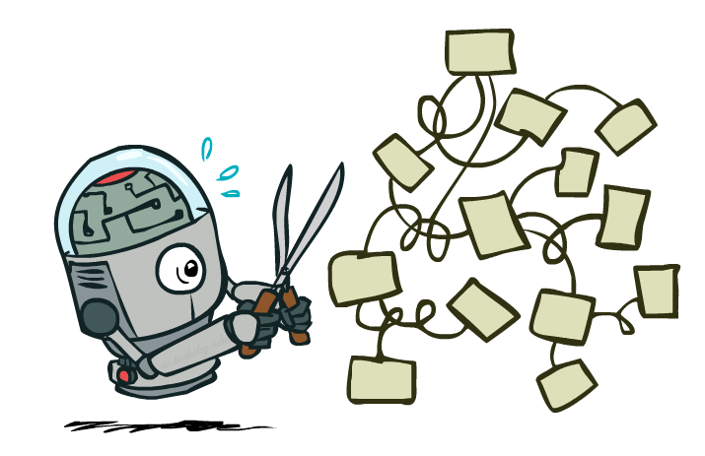
Expectimax Pruning?
3
12
9
2
Notes:
In Minimax we were done, since 2 would always be less than 3.
Here the average of 3, 12 and 9 = 8.
Can the average be less than 2 on the middle node? YES!!! Much harder to prune.

Slide 16



Depth-Limited Expectimax
Estimate of true expectimax value (which would require a lot of work to compute)
400
300
…
…
492
362
…
Notes:
Let’s image they are actually random ghosts. 2 layers of random ghost actions.
At the actual end of the game, we have the score. But we can’t do that so we have to cut the process off.
So we need some way of evaluating the

Slide 17
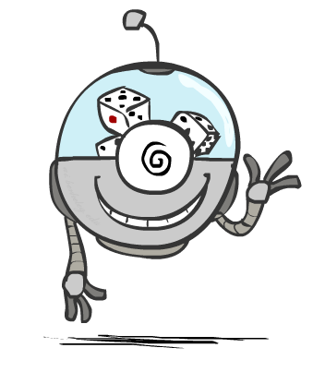
Probabilities

Slide 18
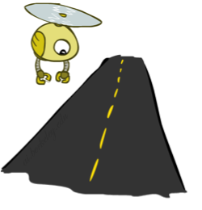
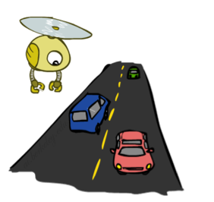
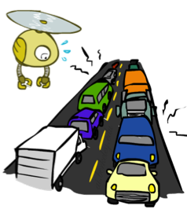
Reminder: Probabilities
A random variable represents an event whose outcome is unknown
A probability distribution is an assignment of weights to outcomes
Example: Traffic on freeway
Random variable: T = whether there’s traffic
Outcomes: T in {none, light, heavy}
Distribution: P(T=none) = 0.25, P(T=light) = 0.50, P(T=heavy) = 0.25
Some laws of probability (more later):
Probabilities are always non-negative
Probabilities over all possible outcomes sum to one
As we get more evidence, probabilities may change:
P(T=heavy) = 0.25, P(T=heavy | Hour=8am) = 0.60
We’ll talk about methods for reasoning and updating probabilities later
0.25
0.50
0.25
Notes:
In general, we will be computing probabilities. As we get more evidence the probabilities will change. We will look at Probabilistic Inference later in this course.

Slide 19
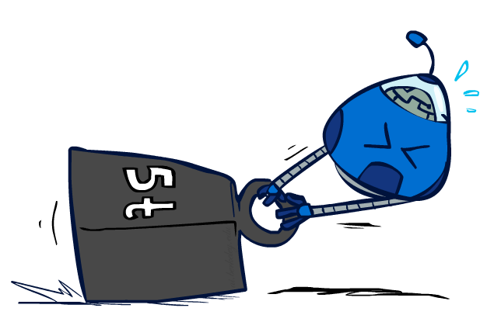
Reminder: Expectations
The expected value of a function of a random variable is the average, weighted by the probability distribution over outcomes
Example: How long to get to the airport?
Time:
20 min
30 min
60 min
+
+
35 min
x
x
x
Probability:
0.25
0.50
0.25

Slide 20
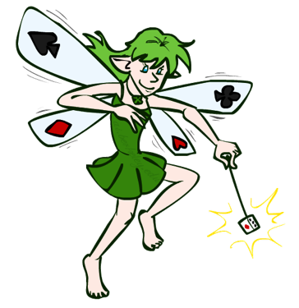
What Probabilities to Use?
In expectimax search, we have a probabilistic model of how the opponent (or environment) will behave in any state
Model could be a simple uniform distribution (roll a die)
Model could be sophisticated and require a great deal of computation
We have a chance node for any outcome out of our control: opponent or environment
The model might say that adversarial actions are likely!
For now, assume each chance node magically comes along with probabilities that specify the distribution over its outcomes
Having a probabilistic belief about another agent’s action does not mean that the agent is flipping any coins!
Notes:
Where do the probabilities come from? For today, they come from the probability fairy. They are given by the problem definition. Later we will look at how to compute them.

Slide 21
What are Probabilities?
Objectivist / frequentist answer:
Averages over repeated experiments
E.g. empirically estimating P(rain) from historical observation
Assertion about how future experiments will go (in the limit)
New evidence changes the reference class
Makes one think of inherently random events, like rolling dice
Subjectivist / Bayesian answer:
Degrees of belief about unobserved variables
E.g. an agent’s belief that it’s raining, given the temperature
E.g. pacman’s belief that the ghost will turn left, given the state
Often learn probabilities from past experiences (more later)
New evidence updates beliefs (more later)

Slide 22
Quiz: Informed Probabilities
Let’s say you know that your opponent is actually running a depth 2 minimax, using the result 80% of the time, and moving randomly otherwise
Question: What tree search should you use?
Answer: Expectimax!
To figure out EACH chance node’s probabilities, you have to run a simulation of your opponent
This kind of thing gets very slow very quickly
Even worse if you have to simulate your opponent simulating you…
… except for minimax, which has the nice property that it all collapses into one game tree
0.1 0.9
Notes:
…Except, what if your opponent simulates you? You can get into this crazy recursive trees. If you go too far down the computation then
That only really works out for minimax.

Slide 23
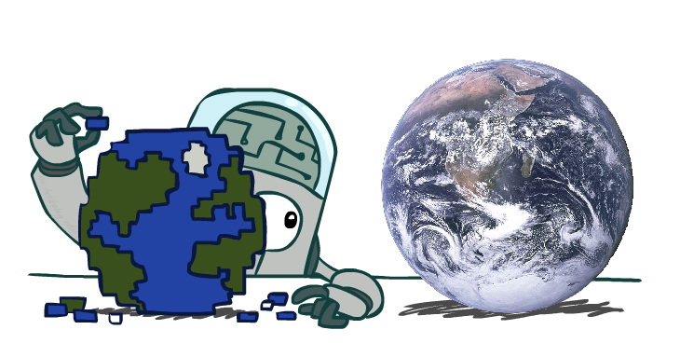
Modeling Assumptions
Notes:
What are the utilities? What are the probabilities? Are the opponents using adversaries strategies, or are the outcomes due to chance?

Slide 24
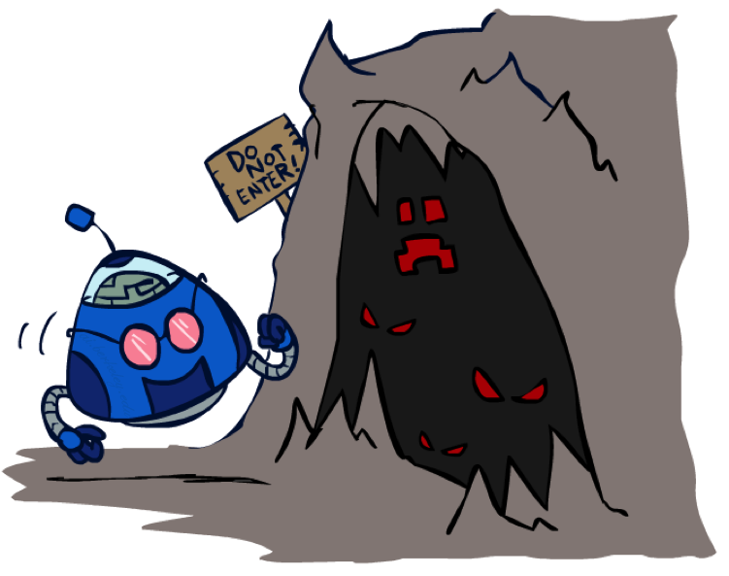
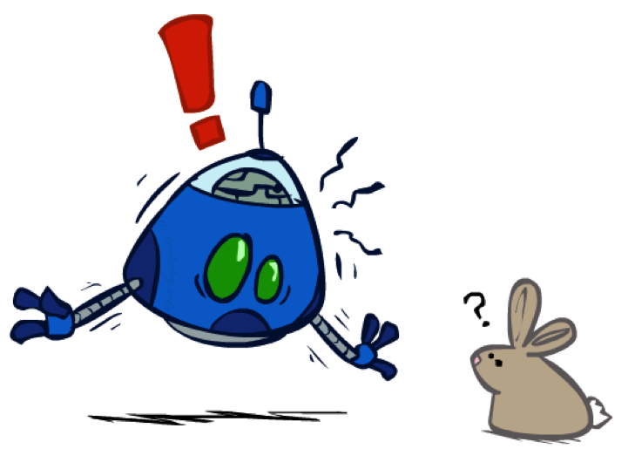
The Dangers of Optimism and Pessimism
Dangerous Optimism
Assuming chance when the world is adversarial
Dangerous Pessimism
Assuming the worst case when it’s not likely
Notes:
Dangerous optimism leads you to do dangerous things, and you’re basically going to get mugged a lot.
Dangerous pessimism. It could be a vampire bunny, but it’s probably not.

Slide 25
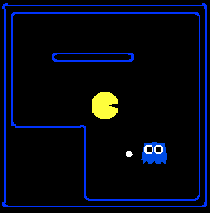
Assumptions vs. Reality
 | Adversarial Ghost | Random Ghost
Minimax Pacman | Won 5/5 Avg. Score: 483 | Won 5/5 Avg. Score: 493
Expectimax Pacman | Won 1/5 Avg. Score: -303 | Won 5/5 Avg. Score: 503
Results from playing 5 games
Pacman used depth 4 search with an eval function that avoids trouble Ghost used depth 2 search with an eval function that seeks Pacman
[Demos: world assumptions (L7D3,4,5,6)]
Notes:
python pacman.py -g SmartGhost -l trapped2 -p ExpectimaxAgent -a depth=4,evalFn=better

Slide 26
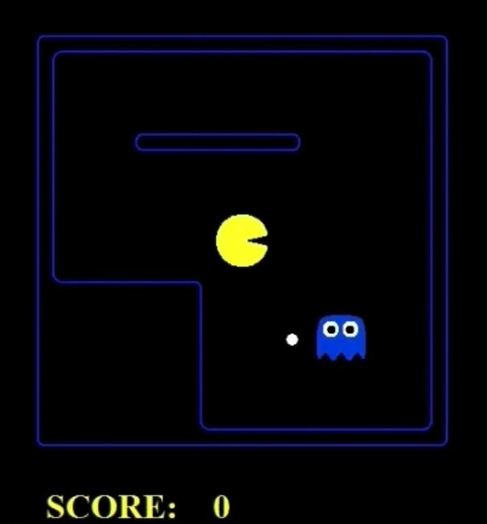
Video of Demo World Assumptions Random Ghost – Expectimax Pacman
 | Adversarial Ghost | Random Ghost
Minimax Pacman | Won 5/5 Avg. Score: 483 | Won 5/5 Avg. Score: 493
Expectimax Pacman | Won 1/5 Avg. Score: -303 | Won 5/5 Avg. Score: 503
Notes:
What’s going to happen? You’re going to go straight to the dot.

Slide 27
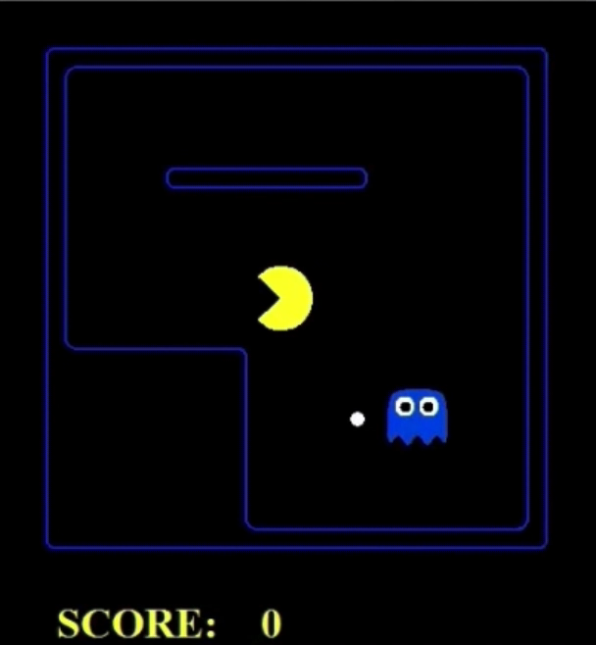
Video of Demo World Assumptions Adversarial Ghost – Minimax Pacman
 | Adversarial Ghost | Random Ghost
Minimax Pacman | Won 5/5 Avg. Score: 483 | Won 5/5 Avg. Score: 493
Expectimax Pacman | Won 1/5 Avg. Score: -303 | Won 5/5 Avg. Score: 503
Notes:
What happens when the ghost is adversarial? You should choose minimax. Your score is going to be lower, but that’s fine. It doesn’t mean that your strategy was wrong, it just meant that the world was harder.

Slide 28
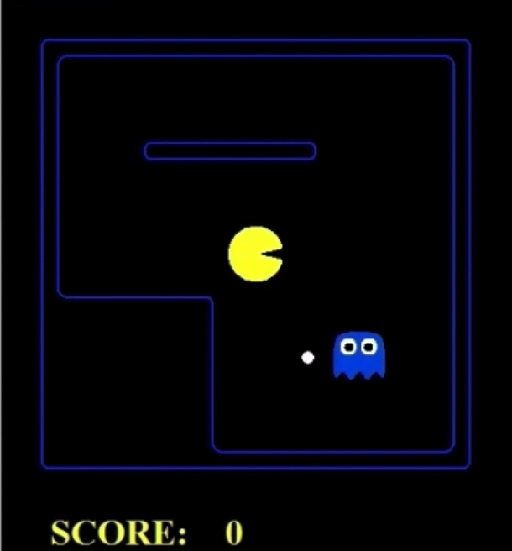
Video of Demo World Assumptions Adversarial Ghost – Expectimax Pacman
 | Adversarial Ghost | Random Ghost
Minimax Pacman | Won 5/5 Avg. Score: 483 | Won 5/5 Avg. Score: 493
Expectimax Pacman | Won 1/5 Avg. Score: -303 | Won 5/5 Avg. Score: 503
Notes:
What happens when you get things wrong? You think that the ghost is random, but it’s adverarial.
The ghost will come right for you, but you don’t know that so you’ll take a risk. Sometimes this works out, sometimes it doesn’t.

Slide 29
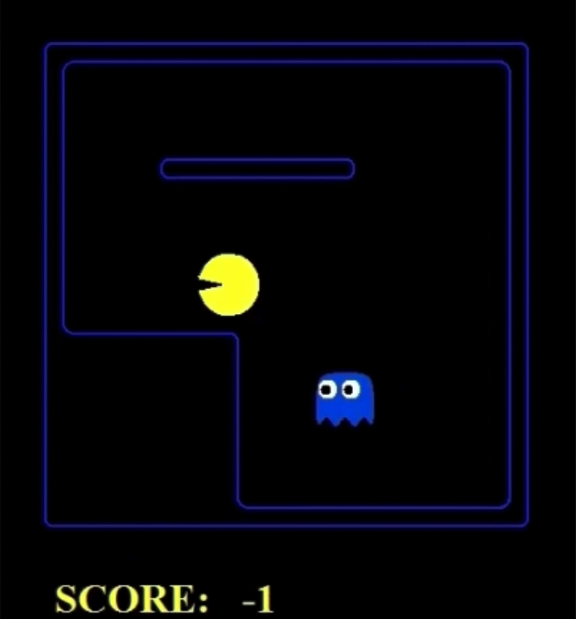
Video of Demo World Assumptions Random Ghost – Expectimax Pacman
 | Adversarial Ghost | Random Ghost
Minimax Pacman | Won 5/5 Avg. Score: 483 | Won 5/5 Avg. Score: 493
Expectimax Pacman | Won 1/5 Avg. Score: -303 | Won 5/5 Avg. Score: 503
Notes:
What happens when the ghost is random, but you think it’s out to get you.
Vampire bunnies!! You’re being pessimistic, but it’s not too dangerous.
Not efficient. You’re scared. Any moment it’s going to launch its master plan.
What’s the ghost doing? It’s just doing its thing.

Slide 30
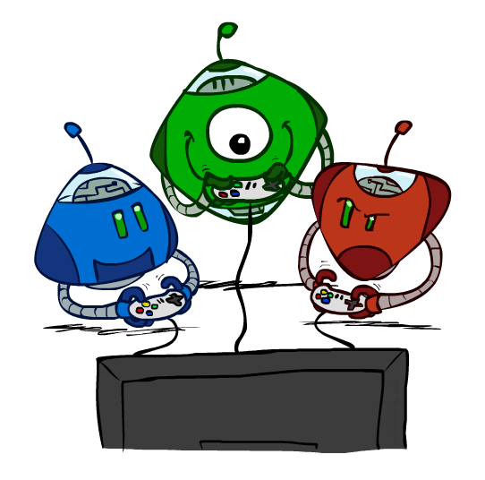
Other Game Types

Slide 31



Mixed Layer Types
E.g. Backgammon
Expectiminimax
Environment is an extra “random agent” player that moves after each min/max agent
Each node computes the appropriate combination of its children
Notes:
I move, you move. Each tie, we roll some dice. This is an expectimenimax tree.
If it’s terminal or we reached our depth limit, return utility.

Slide 32
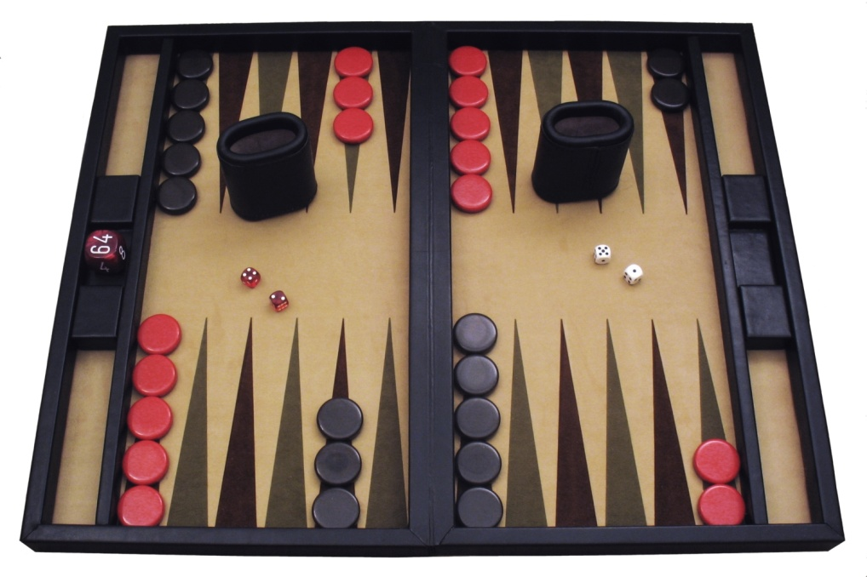
Example: Backgammon
Dice rolls increase b: 21 possible rolls with 2 dice
Backgammon ≈ 20 legal moves
Depth 2 = 20 x (21 x 20)³ = 1.2 x 10⁹
As depth increases, probability of reaching a given search node shrinks
So usefulness of search is diminished
So limiting depth is less damaging
But pruning is trickier…
Historic AI: TDGammon uses depth-2 search + very good evaluation function + reinforcement learning: world-champion level play
1st AI world champion in any game!
Image: Wikipedia

Slide 33
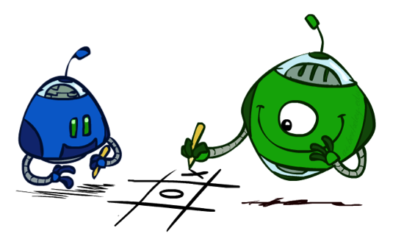
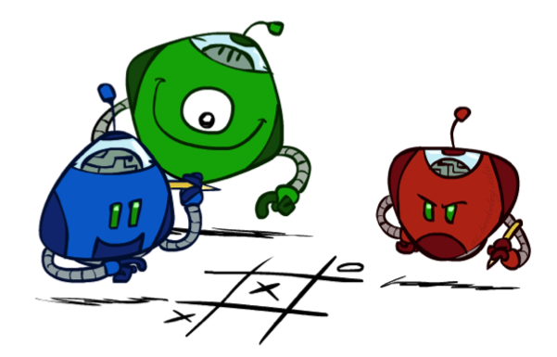
Multi-Agent Utilities
What if the game is not zero-sum, or has multiple players?
Generalization of minimax:
Terminals have utility tuples
Node values are also utility tuples
Each player maximizes its own component
Can give rise to cooperation and
competition dynamically…
1,6,6
7,1,2
6,1,2
7,2,1
5,1,7
1,5,2
7,7,1
5,2,5
Notes:
3 players, red green and blue
Terminal nodes encodes how much it is worth to each of the plaers.
Leftmost green node will select 1,6,6. Similarly, blue would select that. So it looks like we’re competing against red, but we’re really not. That’s just that our utility functions are aligned in this case. It’s really cool. Complex behavior is emerging from something simpler.

Slide 34
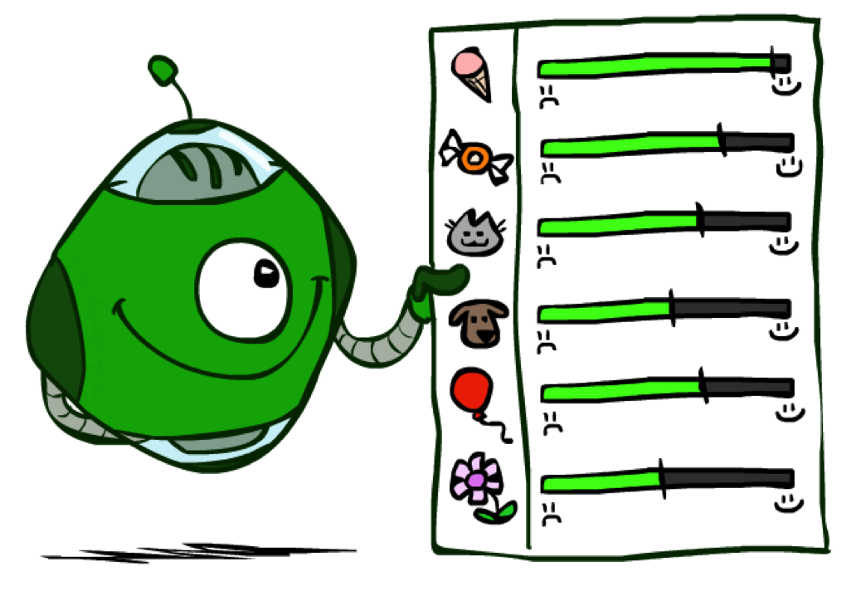
Utilities
Notes:
Everything in minimax and expectimax has referenced the notion of Utilties. The idea that there are values that you can go around either maximizing or minimizing or taking the average of.
What are these numbers? Where do they come from? How do we even know that they exist?

Slide 35

Maximum Expected Utility
Why should we average utilities? Why not minimax?
Principle of maximum expected utility:
A rational agent should chose the action that maximizes its expected utility, given its knowledge
Questions:
Where do utilities come from?
How do we know such utilities even exist?
How do we know that averaging even makes sense?
What if our behavior (preferences) can’t be described by utilities?
Notes:
If we have utilities, why should we ever average them?
The answer is vampire bunnies. Worst case reasoning only works if your model is able to assign very low probabilities to very bad events. You need probabilistic reasoning and averages.
This is going to lead us down the path of probabilistic reasoning.
Are humans so complex that they can’t be boiled down to these probabilities?

Slide 36
What Utilities to Use?
0
40
20
30
x²
0
1600
400
900
For worst-case minimax reasoning, terminal function scale doesn’t matter
We just want better states to have higher evaluations (get the ordering right)
We call this insensitivity to monotonic transformations
For average-case expectimax reasoning, we need magnitudes to be meaningful
Notes:
Minimax is really about the ordering of the states.
IN expectiax, the right tree would give me average of 20 and 25, so I would take the right branch. What about in the right tree? That would give me 800 and 650, so I would take the left branch.
The magnitudes are very important here.

Slide 37

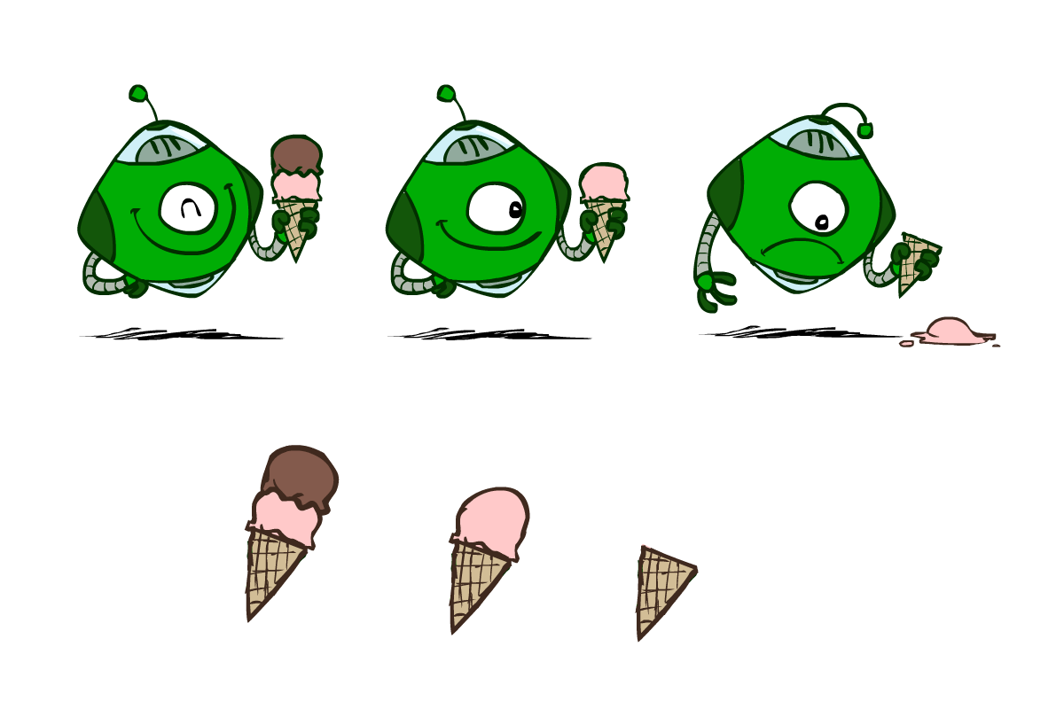
Utilities
Utilities are functions from outcomes (states of the world) to real numbers that describe an agent’s preferences
Where do utilities come from?
In a game, may be simple (+1/-1)
Utilities summarize the agent’s goals
Theorem: any “rational” preferences can be summarized as a utility function
We hard-wire utilities and let behaviors emerge
Why don’t we let agents pick utilities?
Why don’t we prescribe behaviors?

Slide 38
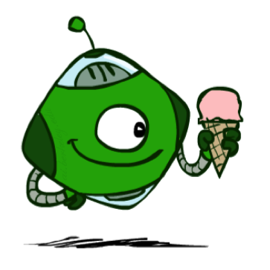
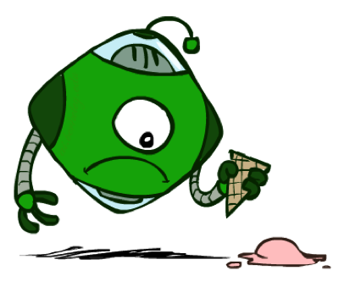
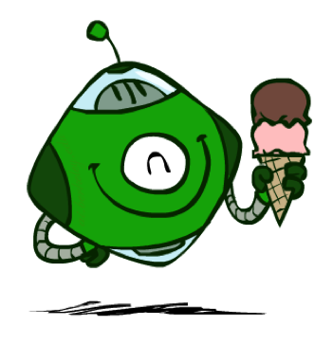
Utilities: Uncertain Outcomes
Getting ice cream
Get Single
Get Double
Oops
Whew!
Notes:
The robot has to choose not only between utilities, but also uncertain outcomes.

Slide 39
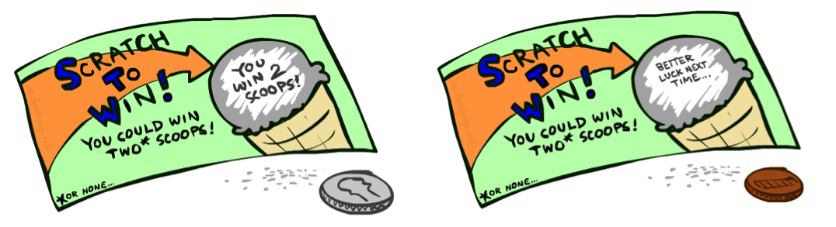
Preferences
A Prize
A Lottery
An agent must have preferences among:
Prizes: A, B, etc.
Lotteries: situations with uncertain prizes
Notation:
Preference:
Indifference:
A
p 1-p
A B
Notes:
A prize is a given outcome.
Lotteries are mixtures with probabilities attached.

Slide 40
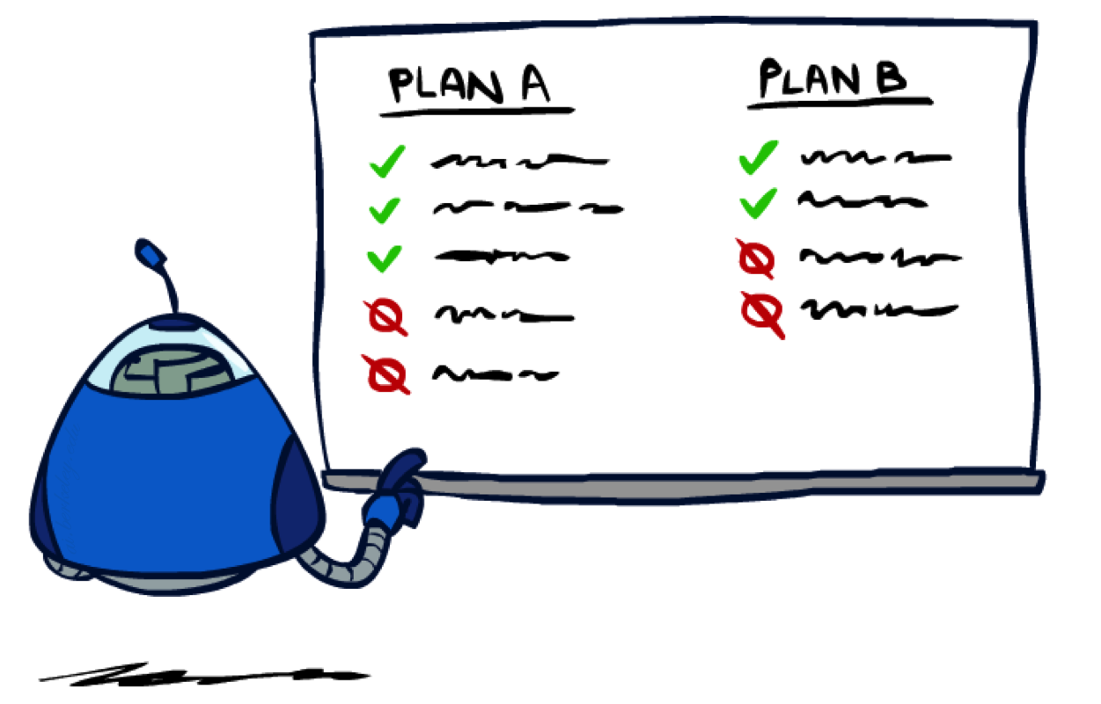
Rationality
Notes:
Are there good preferences and bad preferences? What do we need in order to decide is an agent is rational?

Slide 41
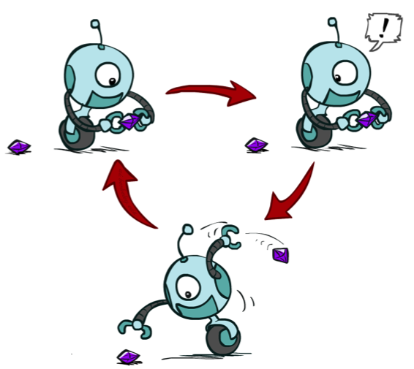
Rational Preferences
We want some constraints on preferences before we call them rational, such as:
For example: an agent with intransitive preferences can
be induced to give away all of its money
If B > C, then an agent with C would pay (say) 1 cent to get B
If A > B, then an agent with B would pay (say) 1 cent to get A
If C > A, then an agent with A would pay (say) 1 cent to get C
Axiom of Transitivity:
Notes:
Apple, banana, carrot
Some things don’t make sense.
... This is a defect in behavior.

Slide 42

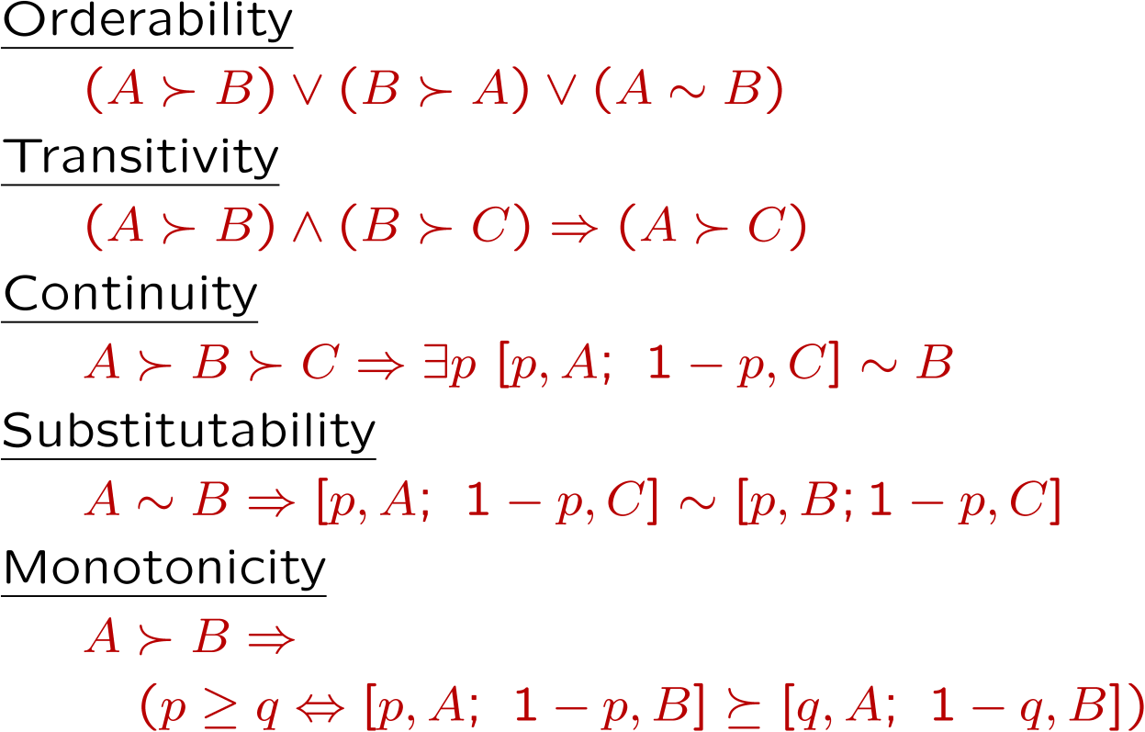
Rational Preferences
The Axioms of Rationality
Theorem: Rational preferences imply behavior describable as maximization of expected utility
Notes:
Orderability. You have to like A better or B better or be indifferent.
Transitivity, we just saw.
Continuity. More subtle. If you like A better than C and B is somewhere in the middle. Then there has to be some lottery between A and C, where you’re indifferent with B.
Substitutability. If they’re exchangeable on their own then they are exchangeable in a lottery.
Monotonicity. Also reasonable. If A is better than B, and you have a lottery between A and B, then you would prefer more A in the mix.
If you accept these actions, then rational preferences that obey these, then all of your behavior is describable by maximizing utilities.

Slide 43
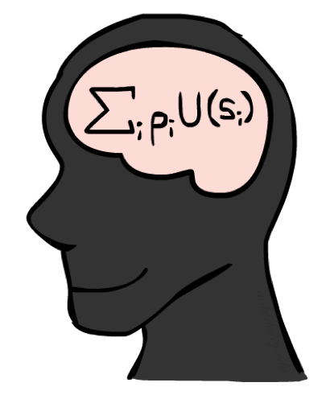
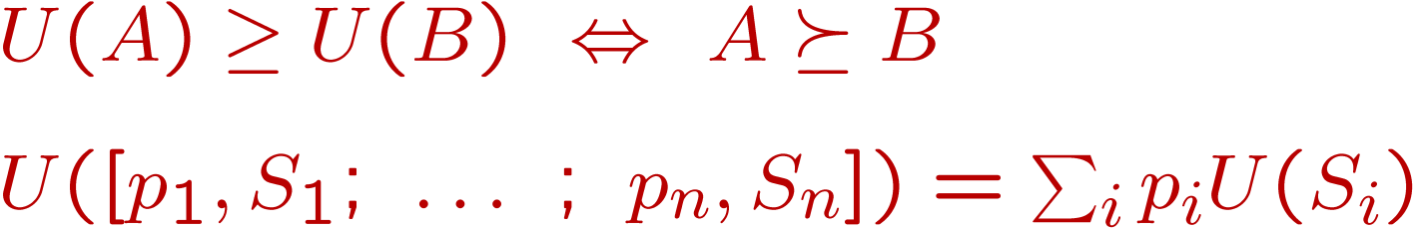
MEU Principle
Theorem [Ramsey, 1931; von Neumann & Morgenstern, 1944]
Given any preferences satisfying these constraints, there exists a real-valued
function U such that:
I.e. values assigned by U preserve preferences of both prizes and lotteries!
Maximum expected utility (MEU) principle:
Choose the action that maximizes expected utility
Note: an agent can be entirely rational (consistent with MEU) without ever representing or manipulating utilities and probabilities
E.g., a lookup table for perfect tic-tac-toe, a reflex vacuum cleaner
Notes:
Here’s the theorem.
There exists a real valued function U with the following properties.
U captures your ordinal preferences.
Utility of a lottery is the expectation of the elements of the lottery.
This means the utility captures your preference not only between prizes, but between lotteries!
It’s amazing! It means your utilities are preserved under expectation.
You want your BEHAVIORS to be consistent to the MEU Princple.

Slide 44
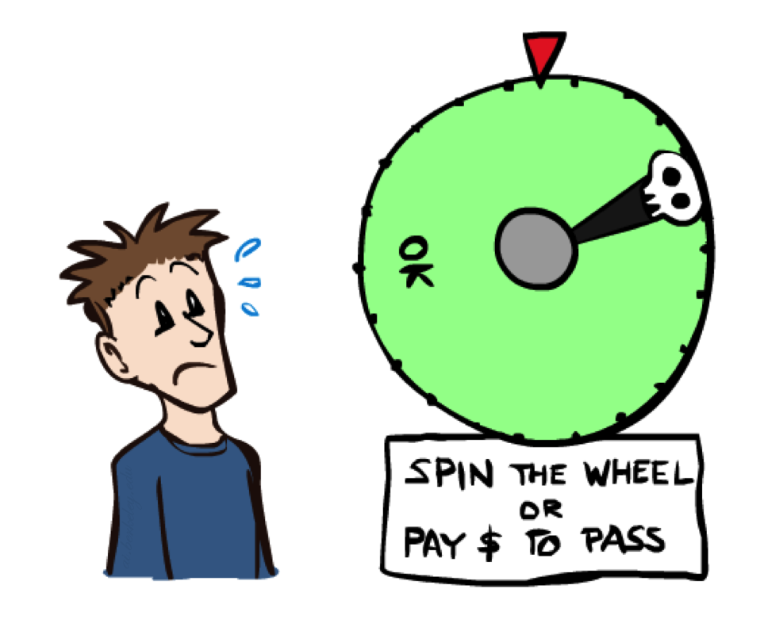
Human Utilities
Notes:
You can be represented with utilities! And MEU.

Slide 45

Utility Scales
Normalized utilities: u₊ = 1.0, u₋ = 0.0
Micromorts: one-millionth chance of death, useful for paying to reduce product risks, etc.
QALYs: quality-adjusted life years, useful for medical decisions involving substantial risk
Note: behavior is invariant under positive linear transformation
With deterministic prizes only (no lottery choices), only ordinal utility can be determined, i.e., total order on prizes
Notes:
These are kind of morbid. Reason about product recalls, where you’re talking about chance of death.
How do I actually get the real valued numbers that you assign to U?
I need to ask you questions about lotteries….

Slide 46


Human Utilities
Utilities map states to real numbers. Which numbers?
Standard approach to assessment (elicitation) of human utilities:
Compare a prize A to a standard lottery L_{p} between
“best possible prize” u₊ with probability p
“worst possible catastrophe” u₋ with probability 1-p
Adjust lottery probability p until indifference: A ~ L_{p}
Resulting p is a utility in [0,1]
Pay $30
0.999999 0.000001
No change
Instant death
Notes:
Elicit preferences.
Slide the value until the person becomes indifferent. That’s the way that I can assign a number to U.
How much do you NOT want to pay $30? No change is better than paying $30, instant death is worse.
Once I find that magical probability that makes you indifferent, then I know U.
If we made it worse, pay $3m be in debt forever.

Slide 47
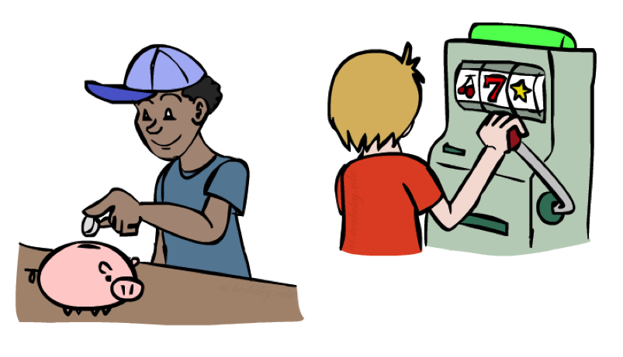
Money
Money does not behave as a utility function, but we can talk about the utility of having money (or being in debt)
Given a lottery L = [p, $X; (1-p), $Y]
The expected monetary value EMV(L) is p*X + (1-p)*Y
U(L) = p*U($X) + (1-p)*U($Y)
Typically, U(L) < U( EMV(L) )
In this sense, people are risk-averse
When deep in debt, people are risk-prone
Notes:
How about money? Can we use money as a utility scale? No! It’s not a good utility scale. We can talk about the utility of money, but it itself isn’t a good utility scale. Why not?
Imagine a lottery where you get X dollars or Y dollars.
Obviously, how good this is depends on X, Y and p.
Typically a utility of a lottery over money is worth less than its equivalent monetary value.
You’d rather have a smaller amount that is guaranteed.
How many of you would like a million dollars?
How many of you would like a billion dollars? How much more? 1000x more? Maybe not?
Let’s say I gave you a billion. Now how much do you want a million? Not much.
Diminishing returns. I’m told after your first billion, your second billion has less utility.
Same thing in the negative. Once you’re $1b in debt, whatever, you’re too big.

Slide 48
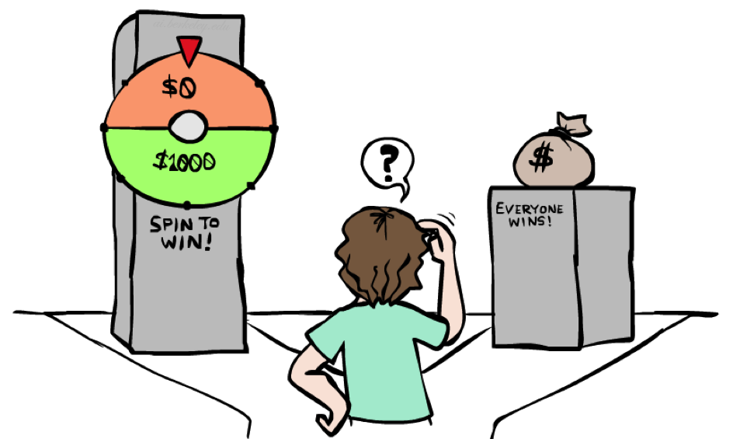
Example: Insurance
Consider the lottery [0.5, $1000; 0.5, $0]
What is its expected monetary value? ($500)
What is its certainty equivalent?
Monetary value acceptable in lieu of lottery
$400 for most people
Difference of $100 is the insurance premium
There’s an insurance industry because people will pay to reduce their risk
If everyone were risk-neutral, no insurance needed!
It’s win-win: you’d rather have the $400 and the insurance company would rather have the lottery (their utility curve is linear and they have many lotteries)
Notes:
Lottery example = $1000 computer, 50% chance that you’ll get it stolen, in which case you are left with $0.
Certainty equivalent. That’s how much money you would be willing to trade this lottery for. Trade uncertainty for certainty.
Certainty equivalent. How much would you trade this lottery for? How many would trade this for $10? How about $900? How about $400?
Because of these preferences there are things like insurance.
Is insurance just a scam? No, it’s win-win!

Slide 49

Example: Human Rationality?
Famous example of Allais (1953)
A: [0.8, $4k; 0.2, $0]
B: [1.0, $3k; 0.0, $0]
C: [0.2, $4k; 0.8, $0]
D: [0.25, $3k; 0.75, $0]
Most people prefer B > A, C > D
But if U($0) = 0, then
B > A ⇒ U($3k) > 0.8 U($4k)
C > D ⇒ 0.8 U($4k) > U($3k)
Notes:
Are humans perfectly rational? Here’s a classic experiment
B is the clear winner.
C is the winner.
Most people prefer C over D.
Multiply C and D by 4 and get the opposite conclusion 0.2*4 = 0.8, 0.25*4 = 1, so 0.8 U($4k) > 1.0 * U($3k)
So what the heck? You’re making irrational preferences? Are you irrational or did I do something wrong?
There’s a lot going on.
Prize B said 100% chance of 3k. 0 is actually important.
What do you get if you choose A, and you win $0? You get the feeling of stupidity.

Slide 50
Uncertainty Everywhere
Not just for games of chance!
I’m sick: will I sneeze this minute?
Email contains “FREE!”: is it spam?
Tooth hurts: have cavity?
60 min enough to get to the airport?
Robot rotated wheel three times, how far did it advance?
Safe to cross street? (Look both ways!)
Sources of uncertainty in random variables:
Inherently random process (dice, etc)
Insufficient or weak evidence
Ignorance of underlying processes
Unmodeled variables
The world’s just noisy – it doesn’t behave according to plan!
Compare to fuzzy logic, which has degrees of truth, rather than just degrees of belief

Slide 51
Next Time: MDPs!

